Slide 1
Chapter 2
Beginning Database Design

Slide 2
Initial Problem Statement
Are part of the Unified Modeling Language (UML), a set of diagramming techniques used to depict various aspects of the software process. Use cases are descriptions of how different types of users (more formally known as actors) might interact with the system.
Use cases can be at many different levels, from high–level corporate goals down to descriptions of small program modules. We will concentrate on the tasks someone sitting in front of a desktop computer would be trying to carry out.
For a database project, these tasks are most likely to be entering or updating data, and extracting information based on that data.

Slide 3
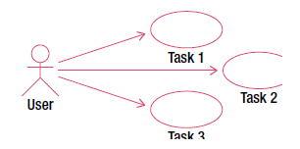
The UML notation for use cases involves stick figures representing, in our case, types of users, and ovals representing each of the tasks that the user needs to be able to carry out.
For example, Figure 2-2 illustrates a use case in which a user performs three as yet unknown tasks.
However, those stick figures and ovals aren’t really enough to describe a given interaction with a system.
When writing a use case, along with a diagram you should create a text document describing in more detail what the use case entails.

Slide 4
Let’s see how use cases can be applied to the problem from Example 1-1 in the last chapter. Figure below recaps where we started with an initial database table recording plants and their uses.

Slide 5
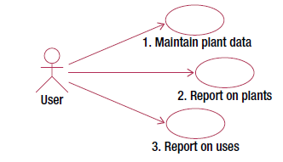
Initial use Cases for the Plant Database
Shows some initial use cases for the plant database. The text following the figure describes each use case.
Use case 1: Enter (or edit) all the data we have about each plant; that is, plant ID, genus, species, common name, and uses.
Use case 2: Find or report information about a plant (or every plant) and see what it is useful for.
Use case 3: Specify a use and find the appropriate plants (or report for all uses).

Slide 6
As explained in the previous chapter, if the data is stored as in Figure below, we cannot conveniently satisfy the requirements of all the use cases in Example 2-1. It is easy to get information about each plant (use case 2) by looking at each row in the table. However, finding all the plants that satisfy a particular use is extremely awkward. Have a go at finding all the plants suitable for firewood. You have to look in each of the use columns for every row.

Slide 7
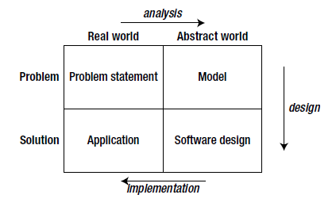
Analysis and Simple Data Model
Now that we have an initial idea of where we are heading, we need to become a little abstract and form a model of what the problem is really about. In terms of Figure 2-1, we are moving across the top of the diagram.

Slide 8
A practical way to start to get a feel for what the data involves is to sketch an initial data model that is a representation of how the different types of data interact.
UML provides class diagrams that are a useful way of representing this information.
There are many products that will maintain class diagrams, but a sketch with pencil and paper is quite sufficient for early and small models.
A large portion of this book is about the intricacies of data modeling, and the following sections provide a quick overview of the definitions and notation.

Slide 9
Classes and Objects
Each class can be considered a template for storing data about a set of similar things (places, events, or people).
Let’s consider Example about plants and their uses. An obvious candidate for our first class is the idea of a Plant.
Each plant can be described in a similar way in that each has a genus, a species, a common_name, and perhaps a plantID number.
These pieces of information, that we will keep about each plant, are referred to as the attributes (or properties) of the class.

Slide 10
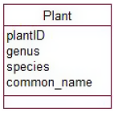
Figure below shows the UML notation for a class and its attributes.
The name of the class appears in the top panel, and the middle panel contains the attributes. For some types of software systems, there may be processes that a class would be responsible for carrying out.
For example, an Order class related to an online shopping cart might have a process for calculating a price including tax. These are known as methods and appear in the bottom panel.
For predominantly information–based problems, methods are not usually a major consideration in the early stages of the design, and we will ignore them for now.

Slide 11
Each plant about which we want to keep data will conform to the template in below; that is, each will have (or could have) its own value for the attributes plantID, genus, species, and common_name.

Slide 12
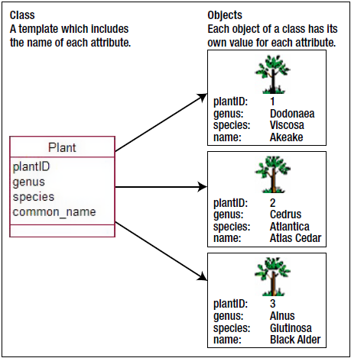
Each individual plant is referred to as an object of the Plant class. The Plant class and some objects are depicted in Figure below.

Slide 13
The Plant class could include other attributes, such as typical height, lifespan, and so on.
What about the uses to which a plant can be put? In the database table in Figure 2-3, these uses were included as several attributes (use1, use2, and so on) of a plant.
In Example 1-1, we saw how having uses stored as several attributes caused a number of problems. What we have here is another candidate for a class: Use. In Chapter 5, we will discuss in more detail how we can figure out whether we need classes or attributes to hold information.
Our new class, Use, will not have many attributes, possibly just name. Each object of the Use class will have a value for name such as “hedging,” “shelter,” or “bird food.” What is particularly interesting for our example is the relationship between the Use and Plant classes.

Slide 14
Relationships
One particular plant object can have many uses. As an example, we can see from Figure 2-3 that Akeake can be used for soil stability, hedging, and shelter. We can think of this as a relationship (or association) between particular objects of the Plant class and objects of the Use class. Some specific instances of this relationship are shown in Figure 2-7.

Slide 15
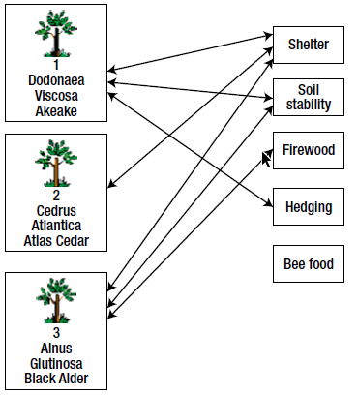
Some specific instances of this relationship are shown in Figure below.

Slide 16
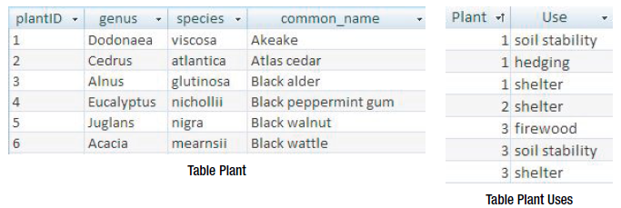
In a database, we would usually create a table for each class, and the information about each object would be recorded as a row in that table as shown in Figure 2-8.
The information about the specific relationship instances would also be recorded in a table.
For a relational database, you would expect to find tables such as those in Figure 2-8 to represent the plants and relationship instances shown in Figure 2-7. We will look further at how and why we design tables like these in Chapter 7. For now, just convince yourself that it contains the appropriate information.

Slide 17
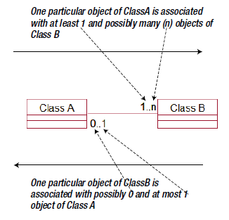
In UML, a relationship is represented by a line between two class rectangles, as shown in below.
The line can be named to make it clear what the relationship is (e.g., “can be used for”), but it doesn’t need to have a name if the context is obvious.
The pair of numbers at each end of the line indicates how many objects of one class can be associated with a particular object of the other class.

Slide 18
The first number is the minimum number. This is usually 0 or 1 and is therefore sometimes known as the optionality (i.e., it indicates whether there must be a related object).
The second number is the greatest number of related objects. It is usually 1 or many (denoted n), although other numbers are possible. Collectively, these numbers can be referred to as the cardinality or the multiplicity of the relationship.

Slide 19
Relationships are read in both directions. Figure 2-9 shows how many objects of the right–hand class can be associated with one particular object of the left–hand class and vice versa.
When we want to know how many objects of ClassB are associated with ClassA, we look at the numbers nearest ClassB.

Slide 20
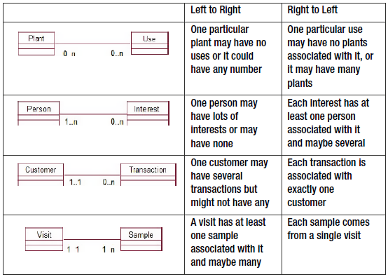
A great deal can be learned about data by investigating the cardinality of relationships, and we will look at the issue of cardinality further in Chapter 4.
The current chapter concentrates on the notation for class diagrams and what the diagrams can tell you about the relationships between different classes. Figure shows some relationships that could be associated with small parts of some of the examples you saw in the Chapter 1.

Slide 21
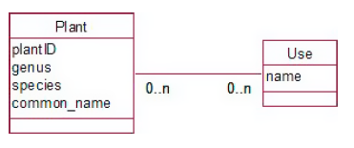
Further Analysis: Revisiting the Use Cases
Using the notation for class diagrams, we can make a first attempt at a data model diagram to represent our plants example.
We have a class for both plants and uses, and the relationship between them looks like:

Slide 22
We now need to check whether this model is able to satisfy the requirements of the three use cases in:
Use case 1: Maintain plant information. We can create objects for each plant and record the attributes we might require now or in the future. We can create use objects, and we can specify relationship instances between particular plant and use objects.
Use case 2: Report on plants. We can take a particular plant object (or each one in turn) and find the values of its attributes. We can then find all the use objects related to that plant object.
Use case 3: Report on uses. We can take a particular use object and find all the plant objects that are related to it.

Slide 23
So far not too bad. But let’s look a bit more carefully. Use case 1 is really two or maybe three separate tasks. If we consider how the database will actually work in practice, it seems likely that the different uses (hedging, shelter, etc.) would be entered right at the start of the project and be updated from time to time.
Entering information about uses is a task that a user might want to perform independently of any specific plant information.
At some later time, the same user, or someone else, may want to enter details of a plant and relate it to the uses that are already recorded.
These are important questions to consider about any use cases related to input. How will it be done in practice? Will different people be involved? Will bits of the data be entered at different times? Answering these questions is the first part of the analysis, where we have to get inside the users’ heads to find out what they really do. (Don’t ever rely on them telling you.)

Slide 24
Now let’s look at use case 2 where we want to report about plants. We can find out more about the problem by probing a bit more deeply into how the user envisages the reporting of information about plants. Think about the following dialog:
You: What order would you like the plants to be listed in?
User: By their genus, I guess. Alphabetical?
You: Genus? So you’d like, for example, all the Eucalyptus plants together.
User: Yep, that would be good.

Slide 25
At this point in the conversation, we see another level of the problem. (Give yourself bonus points if you’ve already thought of the issue I’m about to describe.) If we look carefully at the data in the original table, we can see that it appears that each genus includes a number of species, and each of these species can have many uses.
Another question can confirm whether we understand the relationship between genus and species correctly.
You: So each species belongs to just one genus? Is that right?
User: That’s right.
We can see that asking questions about the reporting use cases in the initial problem statement is another excellent way to find out more about the problem.

Slide 26
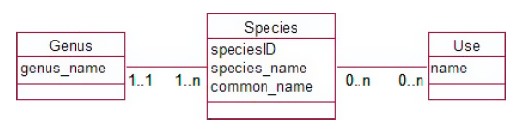
We now realize that we have a new class, Genus, to add to our data model. Why is it important to include this new class? Well, if genus remains as simply an attribute of our original Plant class, we can enter pretty much any value for each object.
Two objects with genus Eucalyptus might end up with different spellings (almost certainly if I were doing the data entry).
This would cause problems every time we wanted to find or count or report on all Eucalyptus plants.
The fact that our user has mentioned that grouping by genus would be useful means that it is important to get the genus data stored appropriately. Our revised data model in Figure 2-12 shows how genus can be represented so that the data is kept accurately.

Slide 27
We now have a set of genus objects, and each plant must be associated with exactly one of them.
You will see in Figure 2-12 that we have also renamed the Plant class to Species, as it is the species, or type of plant, about which we are keeping information, not actual physical plants.
This opens the way for future extension of the model to keep information about actual plants if we so wish (e.g., when each was planted, when it was pruned, and so on). Entering the values of each genus will likely be a separate job from entering data for each species, so it should have its own use case.
We don’t want or need to enter a new object for the Eucalyptus genus every time we enter a new species. Example 2-2 shows the amended use cases. See how the reporting use cases can now be much more precisely defined in terms of the data model.

